Slide 1
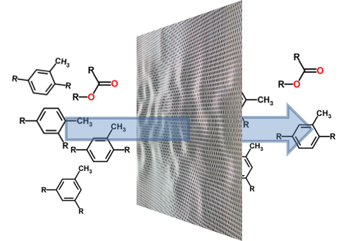
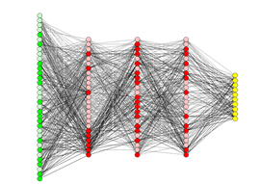
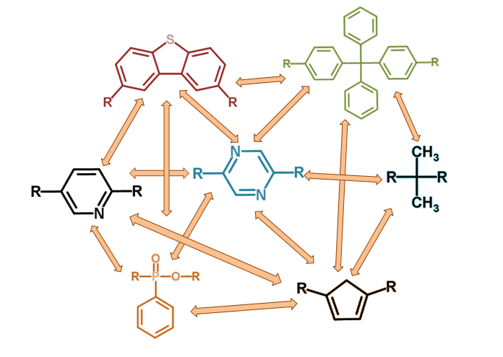
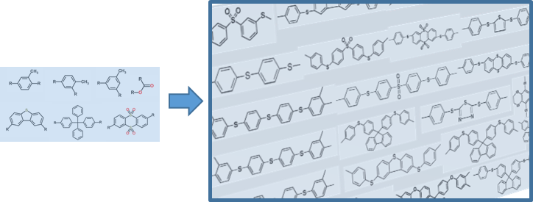
From Virtual High-Throughput Screening and Machine Learning to the Discovery and Rational Design of Polymers for Optical Applications
Mohammad Atif Faiz Afzal Chemical Engineering, University at Buffalo
Advisor: Prof. Johannes Hachmann
Ph.D. Dissertation
May 8th 2018
Notes:
Thank you for the kind introduction Prof. Hachmann. And, thank you all for coming taking the time attend my dissertation defense.
We all know that the breakthrough in the fields of drug discovery, energy, sustainability is mostly by the discovery of new materials , compounds and processes. These days these discoveries is increasingly driven by the use of computational models and tools.

Slide 2


Introduction
uncover promising targets with game-changing properties
provide unique insights beyond the scope of empirical observation
accelerated discovery of novel materials
Study of new chemical entities
Materials with exceptional properties
Challenges in innovation, energy and sustainability
Modeling
High-Throughput
Big Data
New Materials
Notes:
Using computational tools we could study large number of chemical entities which is a key for discovering materials with exceptional properties which is in turn a key for the grand challenges in innovation, energy and sustainability. The progress in these discoveries is increasingly driven by theory modeling, simulations. This is because, it provides an efficient means to uncover promising targets and provide unique insights that are beyond the scope of empirical observation and thus contribute to a solid foundation to finding new things.
And using HTPS techniques we can accelerate the process of discovery.
=============================================
The real-world solutions to grand challenges in innovation, energy, sustainability., etc are to be found in the discovery and development of novel materials, compounds and processes. The progress in these discoveries is increasingly driven by theory modeling, simulations. This is because, it provides an efficient means to uncover promising targets and provide unique insights that are beyond the scope of empirical observation and thus contribute to a solid foundation to finding new things.
We can only make so much progress looking at one compound at a time. If we study one or a handful of compounds, we learn something about these particular compounds. If we study thousands or even millions of compounds, we learn something about all the compounds, but in addition we can learn about the underlying patterns that emerge. That, of course, is also the backdrop of the Materials Genome Initiative.
Transparent optical-quality plastics are extremely important in many commercial optical applications, including camera and projector lenses, and in optometric applications, including prescription eyewear and contact lenses
discovered in the late 1980's that these conjugated polymers behave in many respects like inorganic semiconductors and can be used in a number of semiconducting devices such as field-effect transistors, light-emitting diodes and solar cells . These pioneering discoveries were important milestones for the field of organic electronics, which has now developed into a large international research field with significant academic and industrial activities.

Slide 3
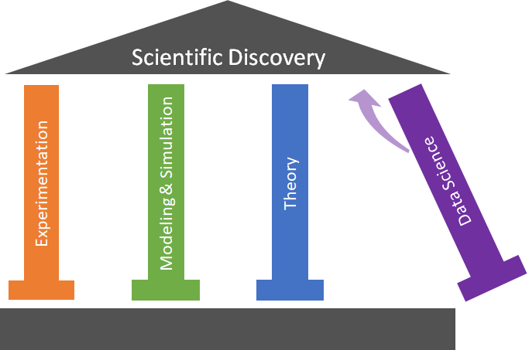
Introduction
rise of Big Data and data-driven approaches: “4th pillar of science”
underlying structure-property relationships
provide necessary insights to realize rational design and inverse engineering
Study of new chemical entities
Materials with exceptional properties
Challenges in innovation, energy and sustainability
Modeling
High-Throughput
Big Data
New Materials
Notes:
And with the rise of Big Data and data-driven approaches now called as the 4th pillar of science we can determine underlying SPR. And further provide insights to realize rational design and inverse engineering.
==========================================
The real-world solutions to grand challenges in innovation, energy, sustainability., etc are to be found in the discovery and development of novel materials, compounds and processes. The progress in these discoveries is increasingly driven by theory modeling, simulations. This is because, it provides an efficient means to uncover promising targets and provide unique insights that are beyond the scope of empirical observation and thus contribute to a solid foundation to finding new things.
thus: they are a valuable asset for synergistic research in chemistry, materials
We can only make so much progress looking at one compound at a time. If we study one or a handful of compounds, we learn something about these particular compounds. If we study thousands or even millions of compounds, we learn something about all the compounds, but in addition we can learn about the underlying patterns that emerge. That, of course, is also the backdrop of the Materials Genome Initiative.
Transparent optical-quality plastics are extremely important in many commercial optical applications, including camera and projector lenses, and in optometric applications, including prescription eyewear and contact lenses
discovered in the late 1980's that these conjugated polymers behave in many respects like inorganic semiconductors and can be used in a number of semiconducting devices such as field-effect transistors, light-emitting diodes and solar cells . These pioneering discoveries were important milestones for the field of organic electronics, which has now developed into a large international research field with significant academic and industrial activities.

Slide 4
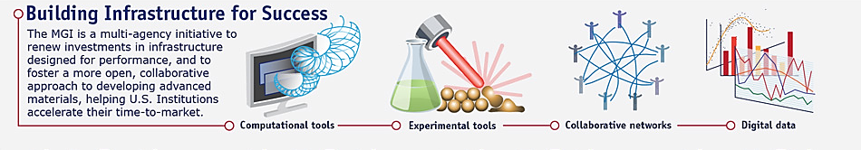
Introduction
valuable asset for synergistic research in chemistry, materials
Materials Genome Initiative, drug discovery, Harvard Clean Energy Project
Study of new chemical entities
Materials with exceptional properties
Challenges in innovation, energy and sustainability
Modeling
High-Throughput
Big Data
New Materials
Notes:
This paradigm of in-silico large scale discovery is a valuable asset for synergistic research in chemistry, materials. This platform is ofcourse is the backdrop of drug discovery, MGI and Harvard Clean Energy Project.
Our work gets the motivation from CEP where focus is on extending the high-throughput virtual screening paradigm from the life sciences to materials applications and provide critical guidance to experimental work. This is a schematic of the group’s software ecosystem.
======================================
The real-world solutions to grand challenges in innovation, energy, sustainability., etc are to be found in the discovery and development of novel materials, compounds and processes. The progress in these discoveries is increasingly driven by theory modeling, simulations. This is because, it provides an efficient means to uncover promising targets and provide unique insights that are beyond the scope of empirical observation and thus contribute to a solid foundation to finding new things.
thus: they are a valuable asset for synergistic research in chemistry, materials
We can only make so much progress looking at one compound at a time. If we study one or a handful of compounds, we learn something about these particular compounds. If we study thousands or even millions of compounds, we learn something about all the compounds, but in addition we can learn about the underlying patterns that emerge. That, of course, is also the backdrop of the Materials Genome Initiative.
Transparent optical-quality plastics are extremely important in many commercial optical applications, including camera and projector lenses, and in optometric applications, including prescription eyewear and contact lenses
discovered in the late 1980's that these conjugated polymers behave in many respects like inorganic semiconductors and can be used in a number of semiconducting devices such as field-effect transistors, light-emitting diodes and solar cells . These pioneering discoveries were important milestones for the field of organic electronics, which has now developed into a large international research field with significant academic and industrial activities.

Slide 5
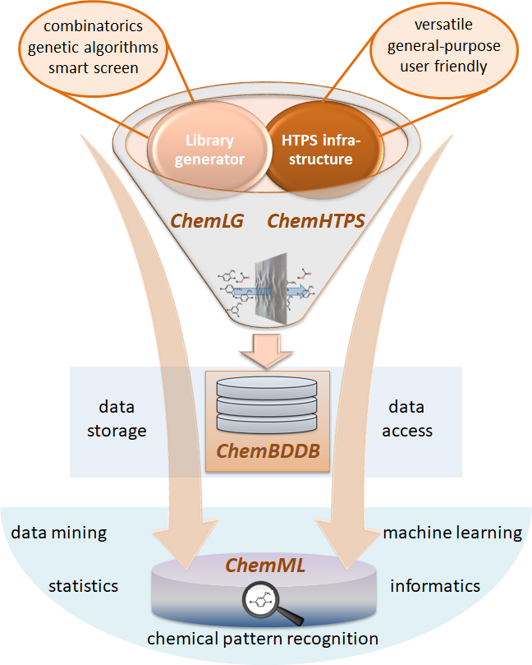
Group’s software ecosystem
ChemLG: a smart and massive parallel molecular library generator
ChemHTPS: an automated virtual high-throughput screening program suite for chemical and materials data generation
ChemBDDB: a big data database template for chemical and materials data storage
ChemML: a machine learning and informatics program suite for chemical and materials data mining
Notes:
This is a schematic of the group’s software ecosystem.
A prerequisite for the high-throughput exploration of chemical space is access to suitable, large-scale screening libraries. We require a corresponding generator for compound and material candidate libraries. A successful approach has to balance the ambition for a systematic and exhaustive enumeration of the combinatorial search space with the need for a smart, responsive, and thus efficient scheme.
So our goal is to create a smart, fast, user-friendly, comprehensive and black-box virtual molecular library generator.
Smart, fast, user-friendly, black-box, comprehensive
=======================================
‘The complete chemical design space for materials and chemicals is too vast to be examined experimentally, creating a real need for efficient and reliable methods to rationally select the exemplary candidates for experimental testing. Transferring the high-throughput virtual screening paradigm from the life sciences to materials applications can provide critical guidance to experimental work; revealing new structures and compositions that may have been missed by the traditional trial-and-error approach.’ MS Combi by schrodinger
A prerequisite for the high-throughput exploration of chemical space is access to suitable, large-scale screening libraries. We require a corresponding generator for compound and material candidate libraries as well as reaction networks. A successful approach has to balance the ambition for a systematic and exhaustive enumeration of the combinatorial search space (which grows exponentially and is thus not viable), with the need for a smart, responsive, and thus efficient scheme.

Slide 6
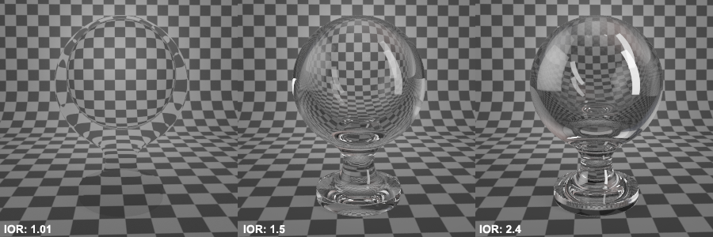
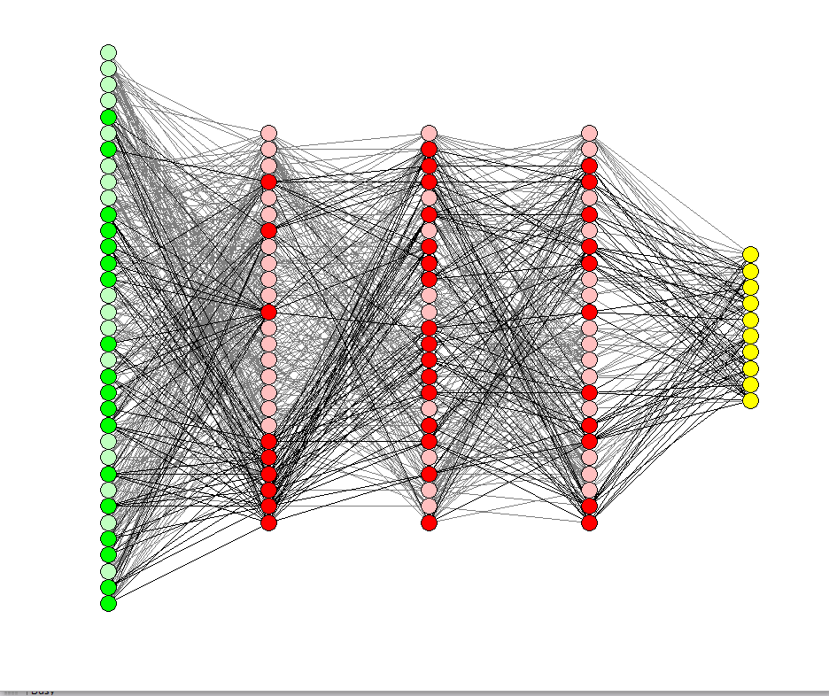
Section II: Accelerating materials discovery using neural networks
Section I: Discovery of high-refractive-index polymers
Notes:
The materials discovery process can be significantly expedited and simplified if we can learn effectively from available knowledge and data. In this presentation, I will show that efficient and accurate prediction of a properties of organic materials is possible by employing advanced machine learning methods trained on results obtained from Molecular dynamics and first-principles calculation
======================================
Using computational tools we could study large number of chemical entities which is a key for discovering materials with exceptional properties which is in turn a key for the grand challenges in innovation, energy and sustainability. The progress in these discoveries is increasingly driven by theory modeling, simulations. This is because, it provides an efficient means to uncover promising targets and provide unique insights that are beyond the scope of empirical observation and thus contribute to a solid foundation to finding new things.
And using HTPS techniques we can accelerate the process of discovery.
=============================================
The real-world solutions to grand challenges in innovation, energy, sustainability., etc are to be found in the discovery and development of novel materials, compounds and processes. The progress in these discoveries is increasingly driven by theory modeling, simulations. This is because, it provides an efficient means to uncover promising targets and provide unique insights that are beyond the scope of empirical observation and thus contribute to a solid foundation to finding new things.
============================================================
We can only make so much progress looking at one compound at a time. If we study one or a handful of compounds, we learn something about these particular compounds. If we study thousands or even millions of compounds, we learn something about all the compounds, but in addition we can learn about the underlying patterns that emerge. That, of course, is also the backdrop of the Materials Genome Initiative.
Transparent optical-quality plastics are extremely important in many commercial optical applications, including camera and projector lenses, and in optometric applications, including prescription eyewear and contact lenses
discovered in the late 1980's that these conjugated polymers behave in many respects like inorganic semiconductors and can be used in a number of semiconducting devices such as field-effect transistors, light-emitting diodes and solar cells . These pioneering discoveries were important milestones for the field of organic electronics, which has now developed into a large international research field with significant academic and industrial activities.

Slide 7
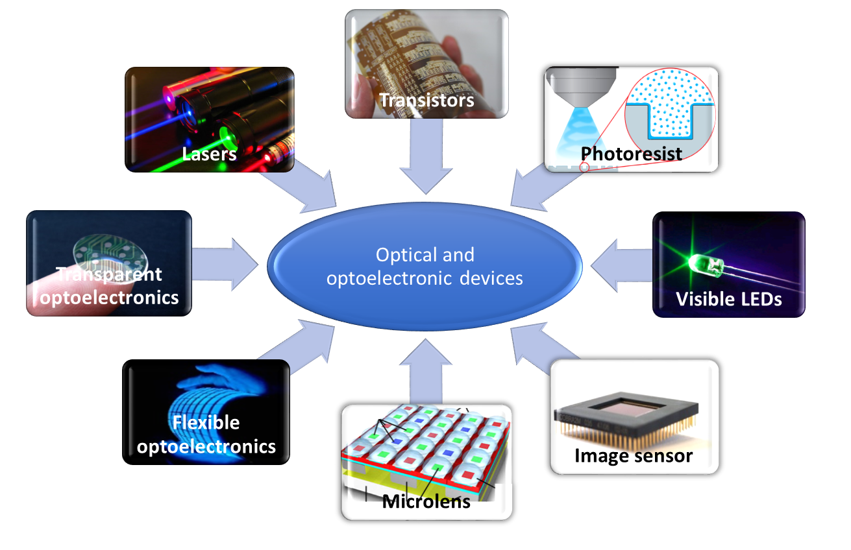
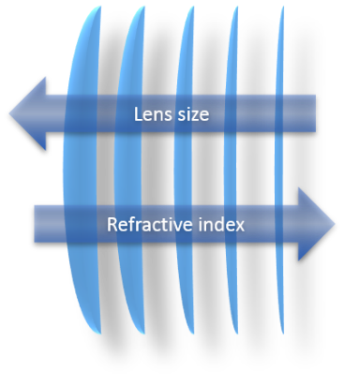
High-refractive-index polymers
plastic material for optic, optometric, optoelectronic applications:
advantages over conventional inorganic materials
flexibility, mechanical stability, light weight and cost effective
anti-reflective coatings, optical adhesives, substrates for advanced displays, microlenses in image sensors
components for PVs, OFETs, OLEDs, lasers
problem: RI > 1.7 needed, but typical C-based polymers have RI ≈ 1.3 to 1.5
Notes:
important optical property - dictates the shape and size of the lens
better flexibility, mechanical stability on impact, light weight and cost effective in manufacturing
complementary metal oxide semiconductor (CMOS)
CCD-charge coupled device
Organic field-effect transistor
anti-reflective coatings, optical adhesives, substrates for advanced displays, microlenses in image sensors
components for PVs, OFETs, OLEDs, lasers
in situ application

Slide 8
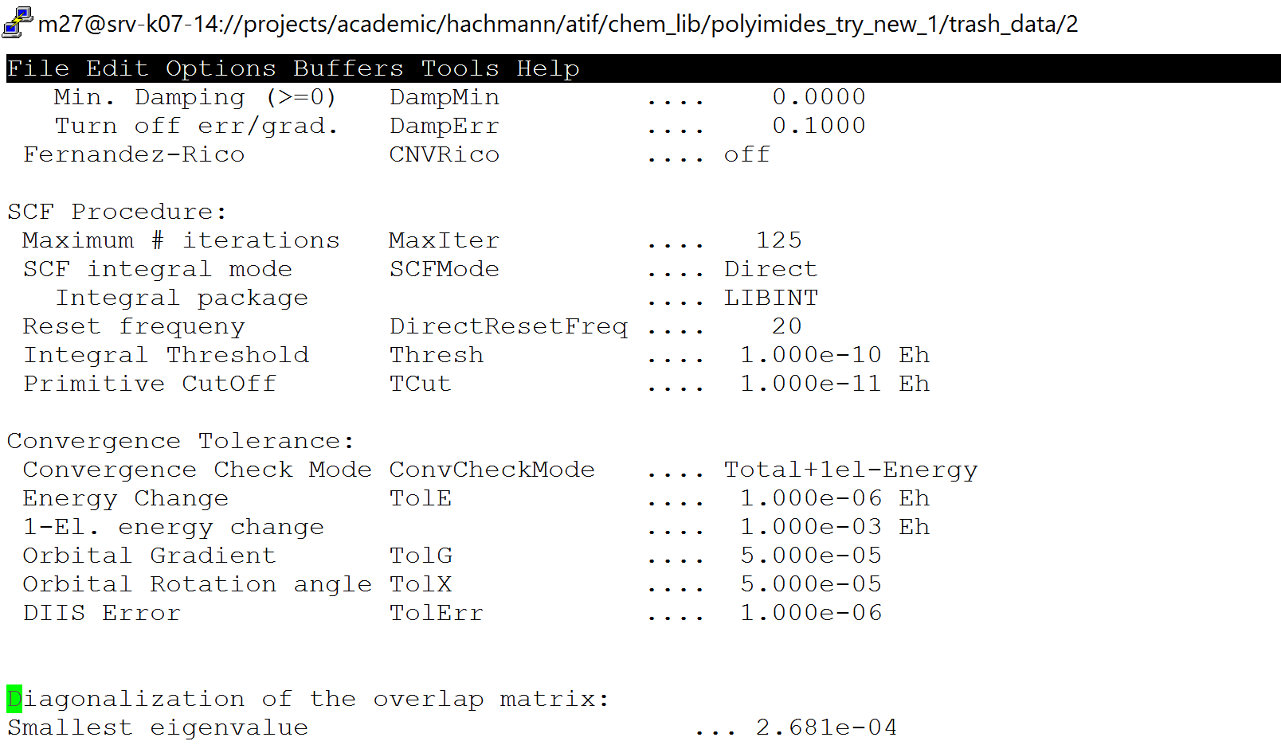
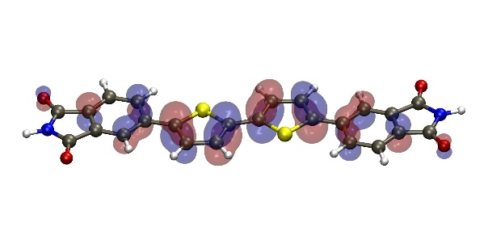

High-refractive-index polymers
Part 1: model development
prediction of polymer refractive index (RI)
Part 2: molecular library generation
generation constraints and smart algorithms
Part 3: high-throughput screening
discovery of high RI polymers
Part 4: structure-property relationships
guide our experimentalist partners → target the most promising candidates
Notes:
This is the outline of my presentation.
My presentation is divided in two parts. In first part I will talk about the model for the prediction of RI of polymers. The model includes calculation of polymer polarizability from first-principles quantum chemistry and benchmarking the polarizability values with different quantum chemistry methods.
Estimation of number density model from van der Waals volume and a machine learning model to correlate packing fraction of bulk polymer with the structure.
And then validation of the model using experimental results from literature.
In the second part I will discuss the high-throughput screening of polymers for discovering high RI polyimides.

Slide 9
High-refractive-index polymers
Part 1: model development
prediction of polymer refractive index (RI)
Part 2: molecular library generation
generation constraints and smart algorithms
Part 3: high-throughput screening
discovery of high RI polymers
Part 4: structure-property relationships
guide our experimentalist partners → target the most promising candidates
Notes:
This is the outline of my presentation.
My presentation is divided in two parts. In first part I will talk about the model for the prediction of RI of polymers. The model includes calculation of polymer polarizability from first-principles quantum chemistry and benchmarking the polarizability values with different quantum chemistry methods.
Estimation of number density model from van der Waals volume and a machine learning model to correlate packing fraction of bulk polymer with the structure.
And then validation of the model using experimental results from literature.
In the second part I will discuss the high-throughput screening of polymers for discovering high RI polyimides.

Slide 10
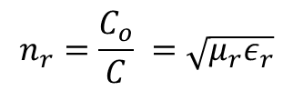
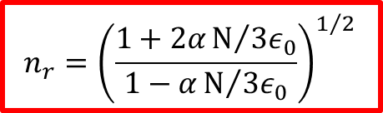
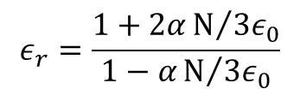
Index of refraction
$$n_{r}=\frac{C_{o}}{C} =\sqrt{μ_{r}ε_{r}}$$
from Maxwell’s equations
$$ε_{r}=\frac{1+2αN/{{3ε}_{0}}}{1−αN/{{3ε}_{0}}}$$
using Lorentz local field approximation
$$n_{r}={\left(\frac{1+2αN/{{3ε}_{0}}}{1−αN/{{3ε}_{0}}}\right)}^{1/2 }$$
Lorentz-Lorenz equation: (Clausius-Mossotti relation)
Notes:
Non-magnetic material → $μ_{r}$ =1
$μ−$ dipole moment, $μ_{0}−\text{permanent} \text{dipole} \text{moment}$, $E−\text{energy}$, $α−\text{polarizability}$, $N−\text{number} \text{density}$, $ε_{0}−\text{vacuum} \text{permittivity}\text{, }ε−\text{electric} \text{field},$
$n_{r}−\text{refractive} \text{index}$, $ρ−\text{density}$, $K_{p}$ $−$ packing fraction, $V﷮vdw−$ Van der Waals volume

Slide 11
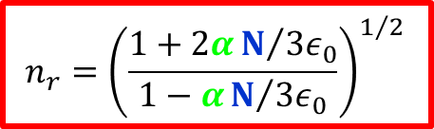
Index of refraction
$$n_{r}=\frac{C_{o}}{C} =\sqrt{μ_{r}ε_{r}}$$
from Maxwell’s equations
$$ε_{r}=\frac{1+2αN/{{3ε}_{0}}}{1−αN/{{3ε}_{0}}}$$
using Lorentz local field approximation
$$n_{r}={\left(\frac{1+2αN/{{3ε}_{0}}}{1−αN/{{3ε}_{0}}}\right)}^{1/2 }$$
Lorentz-Lorenz equation: (Clausius-Mossotti relation)
RI calculation
polarizability
number density (volume & packing fraction)
from first-principles calculations
volume from van der Waals method
molecular polarizability
number density
Notes:
Non-magnetic material → $μ_{r}$ =1
$μ−$ dipole moment, $μ_{0}−\text{permanent} \text{dipole} \text{moment}$, $E−\text{energy}$, $α−\text{polarizability}$, $N−\text{number} \text{density}$, $ε_{0}−\text{vacuum} \text{permittivity}\text{, }ε−\text{electric} \text{field},$
$n_{r}−\text{refractive} \text{index}$, $ρ−\text{density}$, $K_{p}$ $−$ packing fraction, $V﷮vdw−$ Van der Waals volume

Slide 12
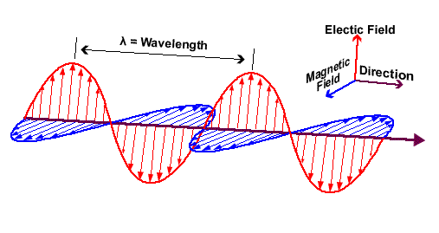
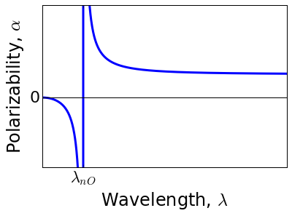
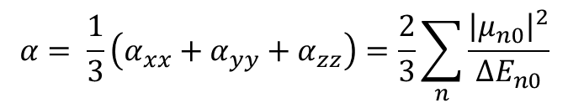
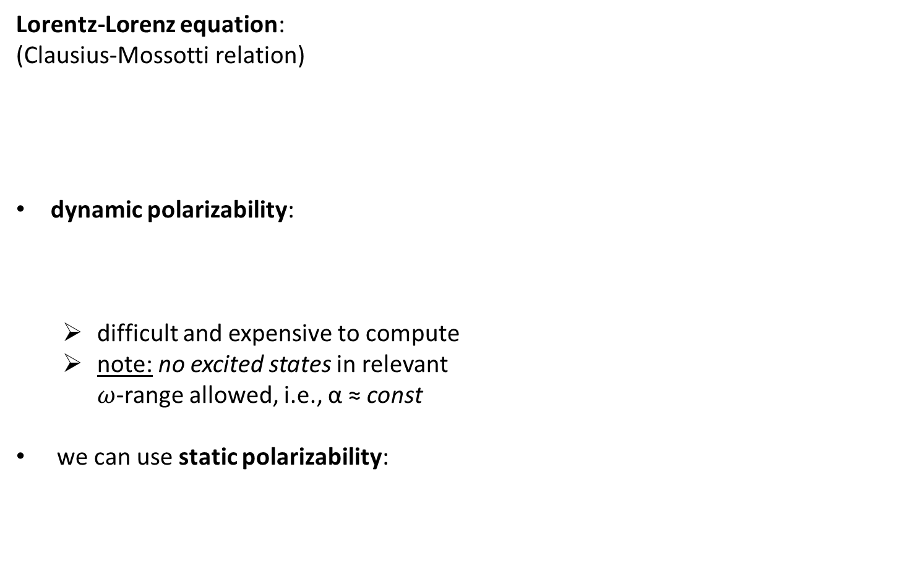
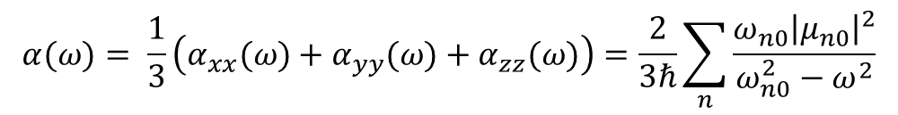

Molecular polarizability
$$n_{r}={\left(\frac{1+2αN/{{3ε}_{0}}}{1−αN/{{3ε}_{0}}}\right)}^{1/2 }$$
Lorentz-Lorenz equation: (Clausius-Mossotti relation)
dynamic polarizability:
difficult and expensive to compute
note: no excited states in relevant $ω$-range allowed, i.e., α ≈ const
we can use static polarizability:
molecular polarizability
$$α(ω)= \frac{1}{3}\left(α_{xx}(ω)+α_{yy}(ω)+α_{zz}(ω)\right)=\frac{2}{3ℏ}\sum_{n}{\frac{{ω_{n0}\left|μ_{n0}\right|}^{2}}{ω_{n0}^{2}−ω^{2}}}$$
$$α= \frac{1}{3}\left(α_{xx}+α_{yy}+α_{zz}\right)=\frac{2}{3}\sum_{n}{\frac{{\left|μ_{n0}\right|}^{2}}{{∆E}_{n0}}}$$
Notes:
Non-magnetic material → $μ_{r}$ =1
$μ−$ dipole moment, $μ_{0}−\text{permanent} \text{dipole} \text{moment}$, $E−\text{energy}$, $α−\text{polarizability}$, $N−\text{number} \text{density}$, $ε_{0}−\text{vacuum} \text{permittivity}\text{, }ε−\text{electric} \text{field},$
$n_{r}−\text{refractive} \text{index}$, $ρ−\text{density}$, $K_{p}$ $−$ packing fraction, $V﷮vdw−$ Van der Waals volume

Slide 13
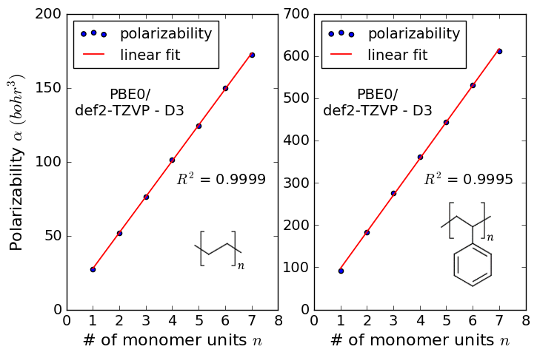
Computational protocol for static polarizability
projection from oligomer results to the polymer limit
early onset of extensivity for non-conjugated polymers
viable extrapolation scheme

Slide 14
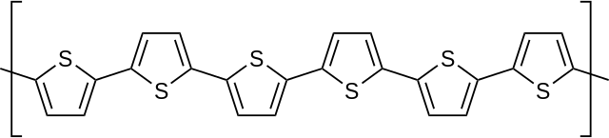
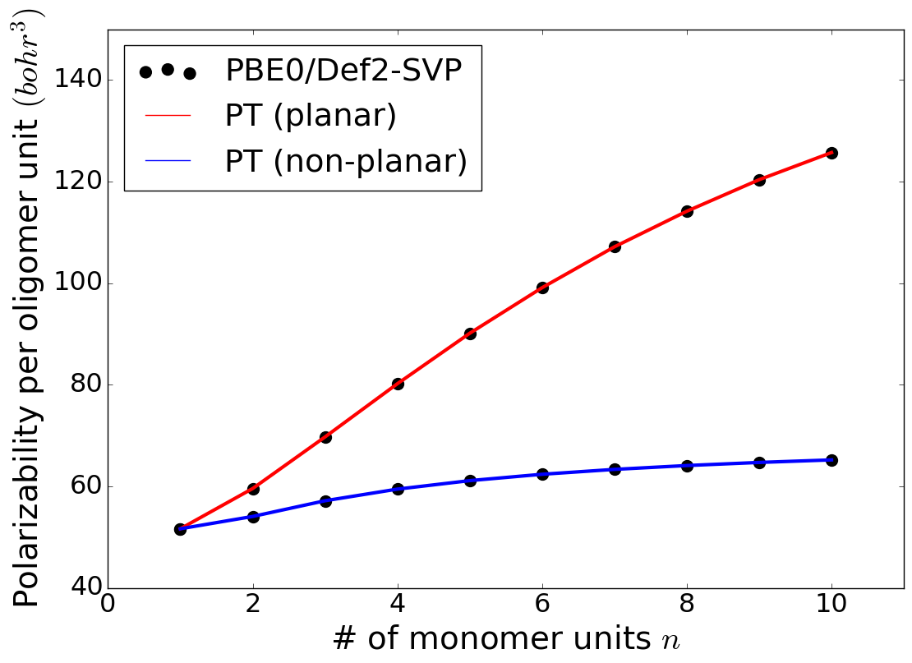
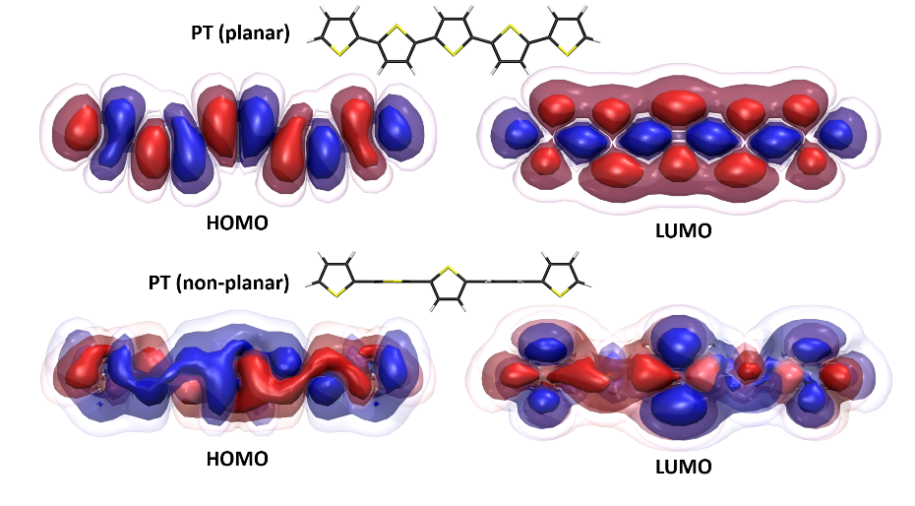
Computational protocol for static polarizability
conjugated polymers →polythiophene

Slide 15
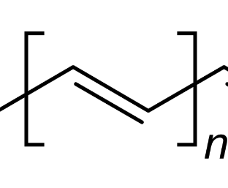
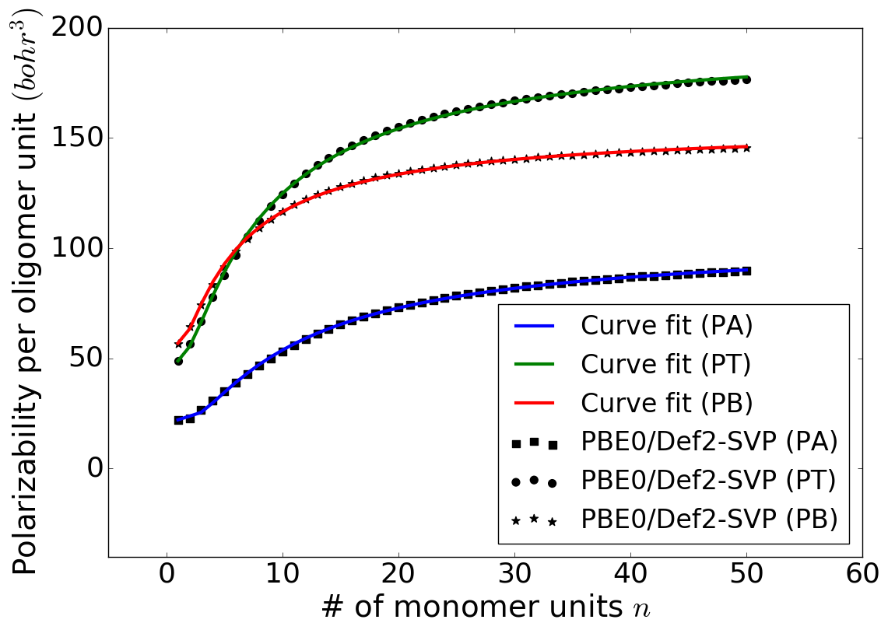
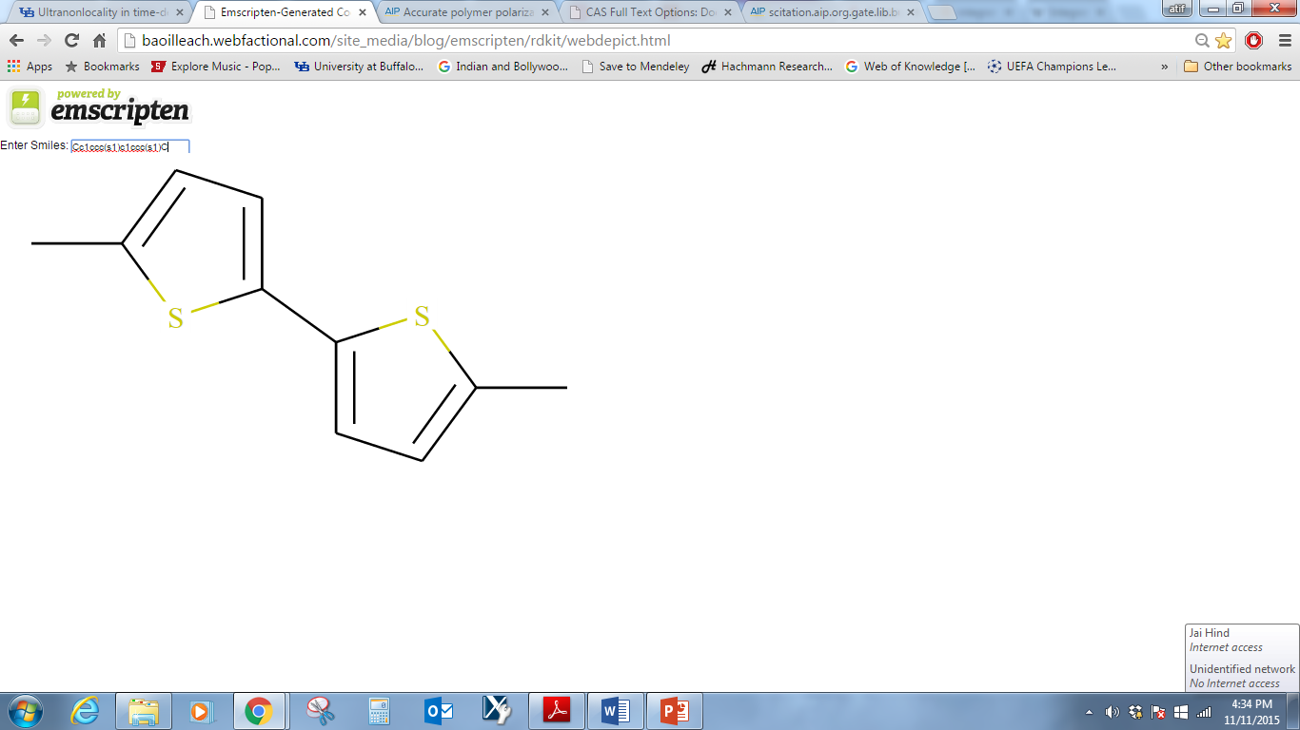
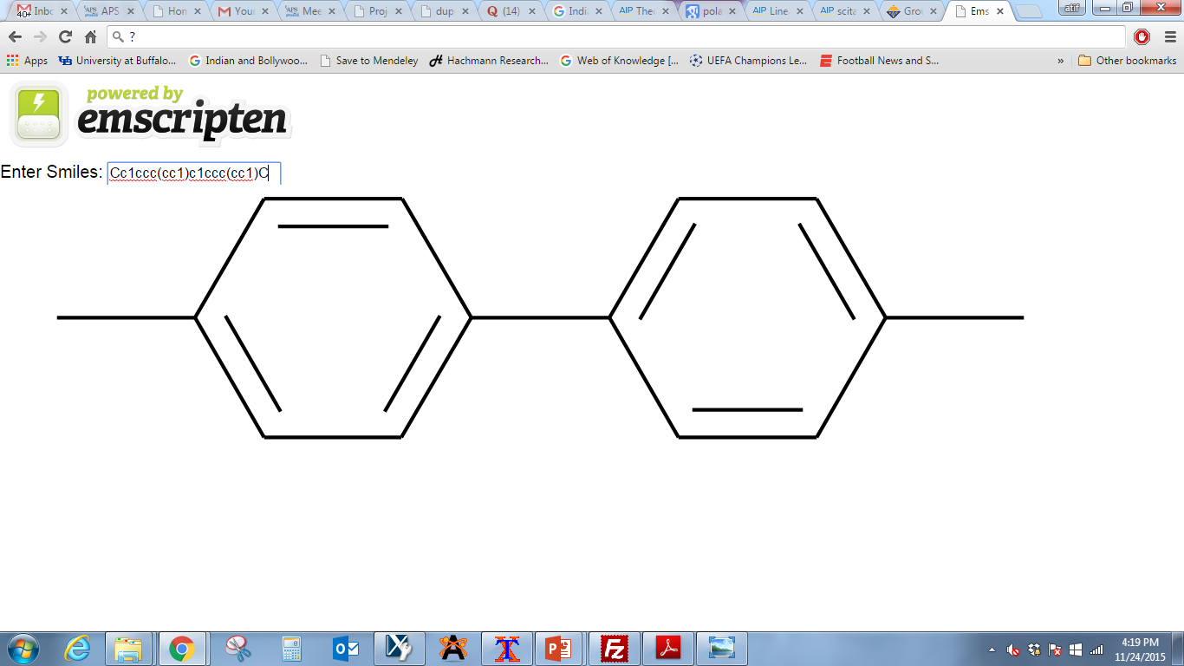
Computational protocol for static polarizability
non-conjugated polymers: 1-4 monomer units
conjugated polymers:
experimental collaborators focus on non-conjugated polymers
PA
[
]_{n}
PT
[
]_{n}
PB

Slide 16
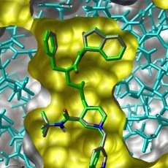

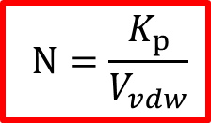
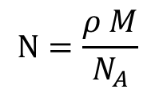
Number density
$$n_{r}={\left(\frac{1+2αN/{{3ε}_{0}}}{1−αN/{{3ε}_{0}}}\right)}^{1/2 }$$
Lorentz-Lorenz equation: (Clausius-Mossotti relation)
number density:
MD simulation via GROMACS
difficult and expensive to compute
approximation via van der Waals volume
number density
$$N=\frac{ρ M}{N_{A}}$$
$$N=\frac{K_{p}}{V_{vdw}}$$
Notes:
Non-magnetic material → $μ_{r}$ =1
$μ−$ dipole moment, $μ_{0}−\text{permanent} \text{dipole} \text{moment}$, $E−\text{energy}$, $α−\text{polarizability}$, $N−\text{number} \text{density}$, $ε_{0}−\text{vacuum} \text{permittivity}\text{, }ε−\text{electric} \text{field},$
$n_{r}−\text{refractive} \text{index}$, $ρ−\text{density}$, $K_{p}$ $−$ packing fraction, $V﷮vdw−$ Van der Waals volume

Slide 17
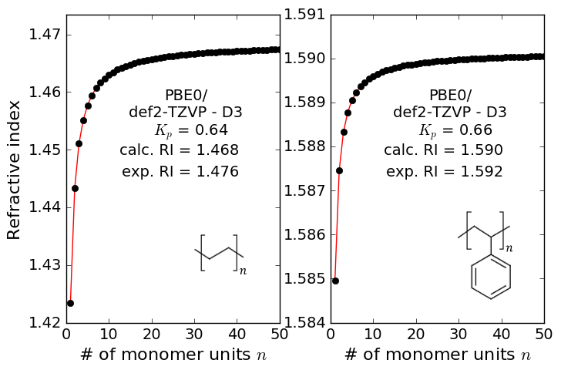
Computational protocol for refractive index
… putting it all together
straightforward extrapolation scheme to polymer limit
RI value for oligomer at n = 50 is a good representation of the polymer RI!

Slide 18
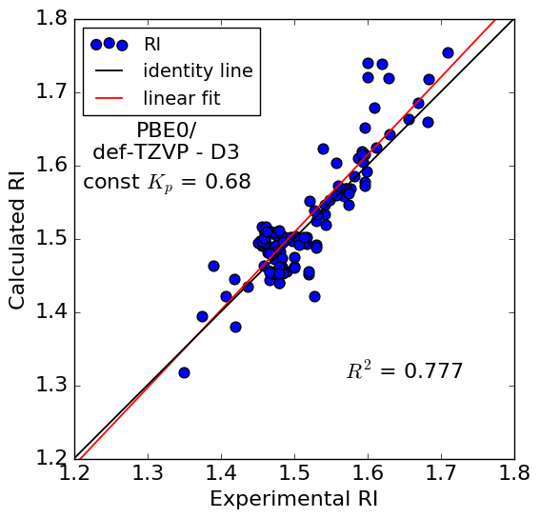
Computational protocol for refractive index
validation via experimental RI values of 112 polymers
RI prediction is not accurate!
what’s going wrong?

Slide 19
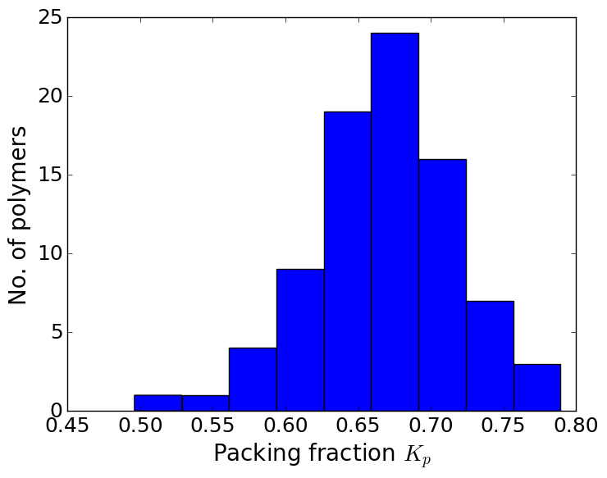
Computational protocol for number density, v2
benchmark different approximations for V_{vdW}: DFT, fragment, …
minor differences
what about the packing factor K_{P}?
literature: K_{P} = 0.68 for average amorphous polymers BUT: actual value can be between 0.55 and 0.78…

Slide 20
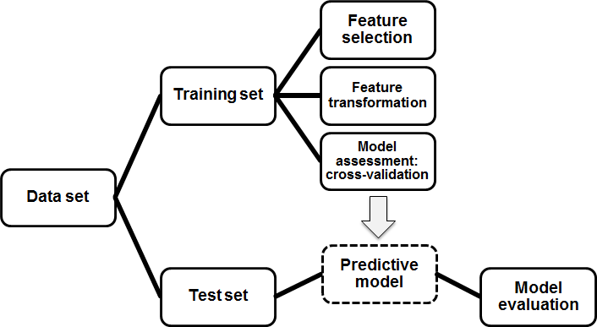
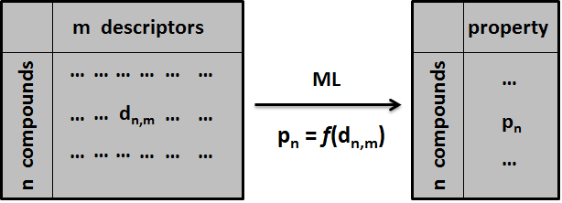
Computational protocol for number density, v2
benchmark different approximations for V_{vdW}: DFT, fragment, …
minor differences
what about the packing factor K_{P}?
literature: K_{P} = 0.68 for average amorphous polymers BUT: actual value can be between 0.55 and 0.78…
ML model for K_{P}
SVM regression model
molecular descriptors from Dragon
model with R² = 0.96 for training set, R² = 0.88 for test set

Slide 21
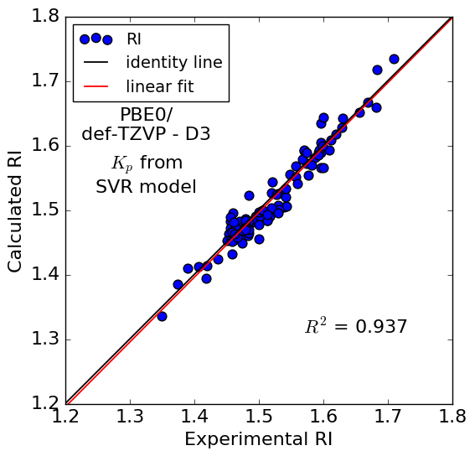
Computational protocol for refractive index, v2
validation vs experimental RI of 112 polymers using K_{p} from SVM
RI prediction is significantly improved!
Afzal, M. A. F.; Cheng, C.; Hachmann, J., The Journal of Chemical Physics 2018, 148 (24).

Slide 22
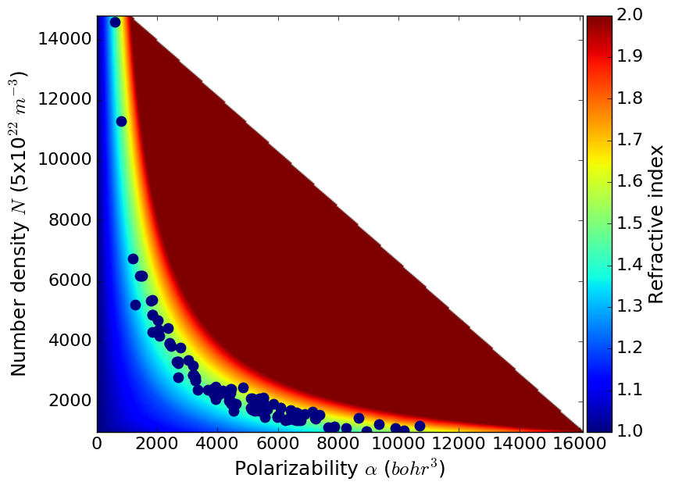
Polarizability vs number density
let's look at the relation between α and N
Notes:
as the polarizability values of the materials increase the density decreases. It is quite a challenge to increase the polarizability values without affecting the density. If we fix on a specific class of materials, the density of the materials will be fairly similar.
We can move towards the region of high RI values with incorporating moieties with high molar polarization. However, doing so might result in the fall of Number density.
If we can create a large library of molecules and use the developed RI model, we can identify moieties that increase the RI values. Lets look an example polymer.

Slide 23
High-refractive-index polymers
Part 1: model development
prediction of polymer refractive index (RI)
Part 2: molecular library generation
generation constraints and smart algorithms
Part 3: high-throughput screening
discovery of high RI polymers
Part 4: structure-property relationships
guide our experimentalist partners → target the most promising candidates
Notes:
This is the outline of my presentation.
My presentation is divided in two parts. In first part I will talk about the model for the prediction of RI of polymers. The model includes calculation of polymer polarizability from first-principles quantum chemistry and benchmarking the polarizability values with different quantum chemistry methods.
Estimation of number density model from van der Waals volume and a machine learning model to correlate packing fraction of bulk polymer with the structure.
And then validation of the model using experimental results from literature.
In the second part I will discuss the high-throughput screening of polymers for discovering high RI polyimides.

Slide 24
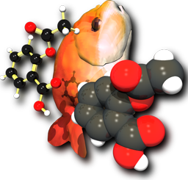

ChemLG: Library generator
molecular library generator
for diverse applications
well-defined chemical space
built using Python + Openbabel
smart algorithms: Genetic Algorithm
massively parallel
designed to run on HPC
Afzal, M. A. F. and Hachmann, J., “ChemLG: A smart and massively parallel molecular library generator.” https://github.com/hachmannlab/chemlg, 2018.
Notes:
A prerequisite for the high-throughput exploration of chemical space is access to suitable, large-scale screening libraries. We require a corresponding generator for compound and material candidate libraries. A successful approach has to balance the ambition for a systematic and exhaustive enumeration of the combinatorial search space with the need for a smart, responsive, and thus efficient scheme.
So our goal is to create a smart, fast, user-friendly, comprehensive and black-box virtual molecular library generator.
ChemLG extends the library enumeration techniques perfected in life sciences research to diverse applications to rapidly create virtual libraries of chemical systems, ready for high-throughput atomic scale simulation enabling virtual screening. Can be used for generating polymers, and other organic molecules for such as optoelectronics, photovoltaics
The generator is designed to run on HPC. This is very helpful because, the generated libraries are used in HTPS which anyhow require HPC and it is also easy to integrate with HTPS infrastructure

Slide 25
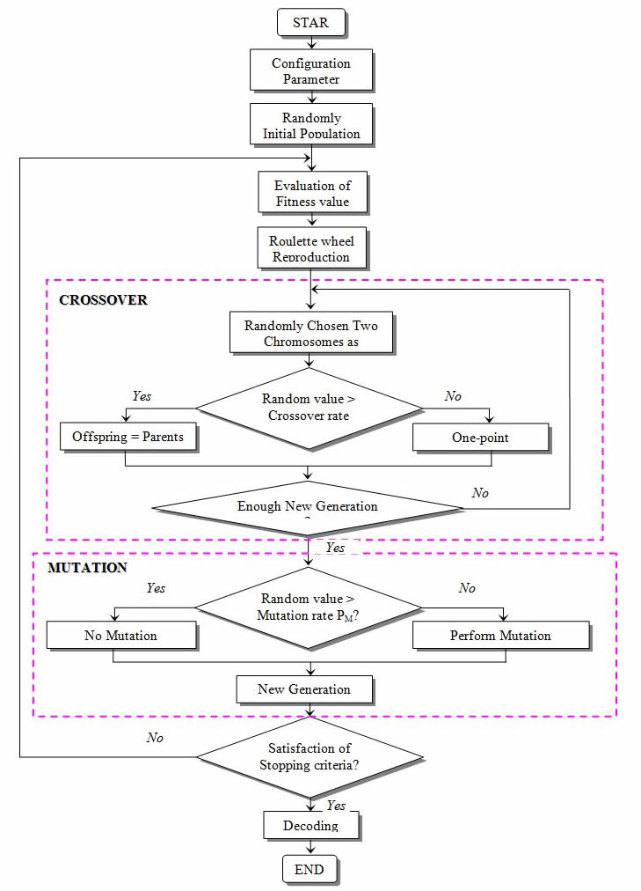
ChemLG: Smart library generation
→Check feasibility
Crossover
can use HTPS framework
→ RI,
1
2
3
4
5
1
2
3
4
5
1
2
3
4
5
→Check feasibility
1
2
3
4
5
Mutation
1
2
3
4
5
→Check feasibility
1
2
3
4
5
GA optimized library

Slide 26
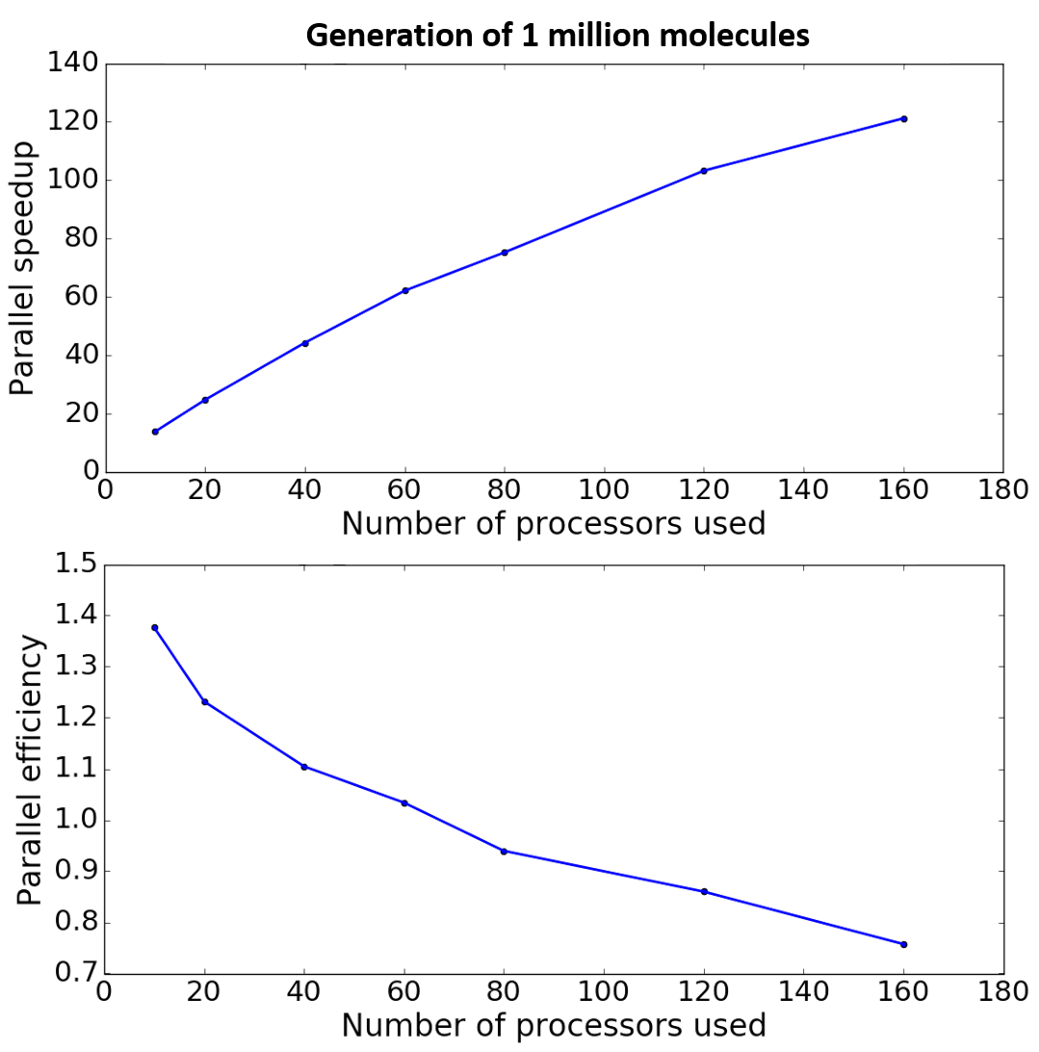
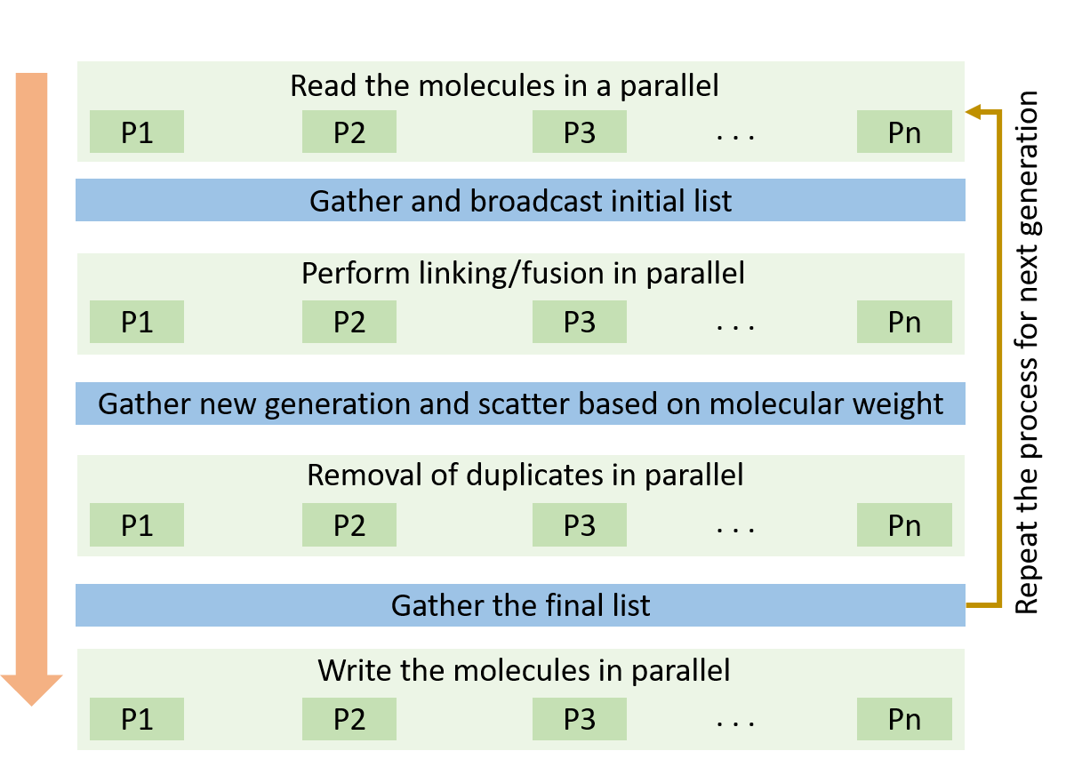
ChemLG: Fast (parallel) library generation
levels of parallelization
read/write molecules
duplicate removal
molecule conversion
Afzal, M. A. F. and Hachmann, J., “ChemLG: A smart and massively parallel molecular library generator.” https://github.com/hachmannlab/chemlg, 2018.
Notes:
Time taken to generate the library depends on the initial building blocks, number of building blocks and generation rules.
This shows that the library generator has an extremely good scalability and can generate million molecules in less than 100 seconds.
In library generation the scalability can effect in the course of duplicate removals at every stage of generation.
Such a good scalability is due to an elegant design of the duplicate removal which does not require communications between the processors

Slide 27
Example: polyimide
polyimide
frequently used in optical devices
high thermal and chemical stability, flame resistance, radiation resistance, mechanical strength, low dielectric constant, and good flexibility
optical properties depend mostly on the R₁ and R₂ moieties
extensively studied to discover new moieties for obtaining high RI polyimide
Notes:
I chose this polymer because it has been extensively studied in the past for various reasons. This class of polymers have incredible properties.
However, optical properties are not suitable to be used in optical optoelectronic device. It has been long known that the optical properties cab be tuned based controlling the structure of R1 and R2. Various solutions have been approached in the past.

Slide 28
Comparison with experiments
validation with experimental RI values
RMSD = 0.024
all these moieties are mostly based on intuition
not all combinations can be studied empirically
more combinations can be virtually generated and evaluated

Slide 29
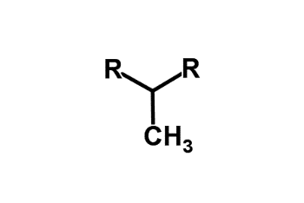
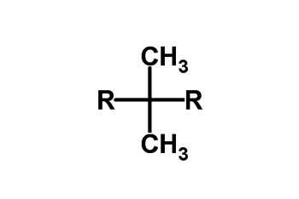
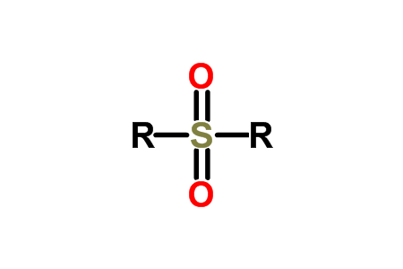
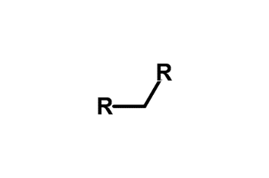
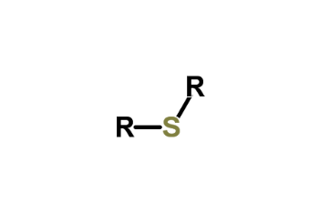

Building blocks for polyimides
R₁
R₂
1
2
3
4
5
6

Slide 30
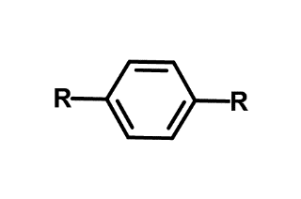






















Building blocks for polyimides
R₁
R₂
7
8
9
10
11
12
13
16
17
18
14
15
19
20
21
22
23
24
25
28
29
26
27

Slide 31
Building blocks for polyimides
R₁
R₂
R₁
58,000 molecules
R₂
220,000 molecules

Slide 32
High-refractive-index polymers
Part 1: model development
prediction of polymer refractive index (RI)
Part 2: molecular library generation
generation constraints and smart algorithms
Part 3: high-throughput screening
discovery of high RI polymers
Part 4: structure-property relationships
guide our experimentalist partners → target the most promising candidates
Notes:
This is the outline of my presentation.
My presentation is divided in two parts. In first part I will talk about the model for the prediction of RI of polymers. The model includes calculation of polymer polarizability from first-principles quantum chemistry and benchmarking the polarizability values with different quantum chemistry methods.
Estimation of number density model from van der Waals volume and a machine learning model to correlate packing fraction of bulk polymer with the structure.
And then validation of the model using experimental results from literature.
In the second part I will discuss the high-throughput screening of polymers for discovering high RI polyimides.

Slide 33

Library generation and HTPS
R₁
58,000 molecules
R₂
220,000 molecules
HTPS
Group’s software ecosystem

Slide 34



ChemBDDB
database of high RI polymers project

Slide 35


RI histogram
let's see what the range of RI for the polyimides looks like
R₂
220,000 molecules
Notes:
Write the number below and explain that it is only for R2

Slide 36
High-refractive-index polymers
Part 1: model development
prediction of polymer refractive index (RI)
Part 2: molecular library generation
generation constraints and smart algorithms
Part 3: high-throughput screening
discovery of high RI polymers
Part 4: structure-property relationships
guide our experimentalist partners → target the most promising candidates
Notes:
This is the outline of my presentation.
My presentation is divided in two parts. In first part I will talk about the model for the prediction of RI of polymers. The model includes calculation of polymer polarizability from first-principles quantum chemistry and benchmarking the polarizability values with different quantum chemistry methods.
Estimation of number density model from van der Waals volume and a machine learning model to correlate packing fraction of bulk polymer with the structure.
And then validation of the model using experimental results from literature.
In the second part I will discuss the high-throughput screening of polymers for discovering high RI polyimides.

Slide 37

Structural patterns of top candidates
R₂
hypergeometric distribution analysis of building blocks to correlate structure and performance
certain building blocks are very common in the top candidates
2
3
4
5
17
28
16
25
Notes:
A positive Z-score indicates that a building block is found more often than is statistically expected in a random distribution, and a negative Z-score registers the opposite
certain building blocks are very common in the top candidates while others are underrepresented.

Slide 38

Structural patterns of top candidates
R₂
hypergeometric distribution analysis of building block pairs to correlate structure and performance
certain building block combinations are prevalent in the top candidates
Notes:
Explain blocks or either green or blue.

Slide 39
Section I summary
accurate prediction model for RI of polymers
successfully created a candidate library of polyimides
virtual high-throughput screening of over 278,000 polymer candidates
identified building blocks that increase RI values
identified which molecular combination is better for HRI polymers
rational, and systematic development of new organic polymers
outlook: synthesis of the most promising polymers, extend the model to other optical properties and also to other class of polymers
Notes:
first-principles quantum chemistry and data modeling
virtual high-throughput
big data approach
Particular interest for the design of future materials
Less promising materials may not be considered for future searches
Narrow down the search to more promising materials
‘Transition from brute-force screening to active design and engineering of new molecular materials’
This framework successful and highly economical in determining the RI values of a wide range of organic polymers
underlying structure property relationships → use this to generate second generation of materials
use of efficient generation algorithms like genetic algorithms
to synthesize the most promising polymers from this study (work in collaboration with experimental expert Prof. Chong Cheng)
apply to different polymer types
extend the model to other optical properties
optical transparency
abbe number
birefringence

Slide 40
Section II: Accelerating materials discovery using neural networks
Notes:
The materials discovery process can be significantly expedited and simplified if we can learn effectively from available knowledge and data. In this presentation, I will show that efficient and accurate prediction of a properties of organic materials is possible by employing advanced machine learning methods trained on results obtained from Molecular dynamics and first-principles calculation
======================================
Using computational tools we could study large number of chemical entities which is a key for discovering materials with exceptional properties which is in turn a key for the grand challenges in innovation, energy and sustainability. The progress in these discoveries is increasingly driven by theory modeling, simulations. This is because, it provides an efficient means to uncover promising targets and provide unique insights that are beyond the scope of empirical observation and thus contribute to a solid foundation to finding new things.
And using HTPS techniques we can accelerate the process of discovery.
=============================================
The real-world solutions to grand challenges in innovation, energy, sustainability., etc are to be found in the discovery and development of novel materials, compounds and processes. The progress in these discoveries is increasingly driven by theory modeling, simulations. This is because, it provides an efficient means to uncover promising targets and provide unique insights that are beyond the scope of empirical observation and thus contribute to a solid foundation to finding new things.
============================================================
We can only make so much progress looking at one compound at a time. If we study one or a handful of compounds, we learn something about these particular compounds. If we study thousands or even millions of compounds, we learn something about all the compounds, but in addition we can learn about the underlying patterns that emerge. That, of course, is also the backdrop of the Materials Genome Initiative.
Transparent optical-quality plastics are extremely important in many commercial optical applications, including camera and projector lenses, and in optometric applications, including prescription eyewear and contact lenses
discovered in the late 1980's that these conjugated polymers behave in many respects like inorganic semiconductors and can be used in a number of semiconducting devices such as field-effect transistors, light-emitting diodes and solar cells . These pioneering discoveries were important milestones for the field of organic electronics, which has now developed into a large international research field with significant academic and industrial activities.

Slide 41

Comparison of methods for density
Method | R² | MAPE | MAE
vdW from Slonimski’s method | 0.820 | 5.62 | 45.97
vdW from wavefunction | 0.856 | 4.91 | 29.31
molecular dynamics (MD)* | 0.990 | 1.11 | 7.50
MD is the best technique to calculate density
developed MD model to calculate density
GAFF, GROMACS
* Park et al, Chemical Physics Letters, 2003
NVT step
Notes:
22 organic molecules (liq)
Wavefunction calculated by Jun
Assumes a constant packing fraction
Clearly the MD is the best method

Slide 42

Comparison of methods for density
Method | R² | MAPE | MAE
vdW from Slonimski’s method | 0.820 | 5.62 | 45.97
vdW from wavefunction | 0.856 | 4.91 | 29.31
molecular dynamics (MD)* | 0.990 | 1.11 | 7.50
MD is the best technique to calculate density
developed MD model to calculate density
GAFF, GROMACS
* Park et al, Chemical Physics Letters, 2003
NPT step
Notes:
22 organic molecules (liq)
Wavefunction calculated by Jun
Assumes a constant packing fraction
Clearly the MD is the best method

Slide 43
Comparison of methods for density
Method | R² | MAPE | MAE
vdW from Slonimski’s method | 0.820 | 5.62 | 45.97
vdW from wavefunction | 0.856 | 4.91 | 29.31
molecular dynamics (MD)* | 0.990 | 1.11 | 7.50
MD is the best technique to calculate density
developed MD model to calculate density
GAFF, GROMACS
validation using 175 organic molecules
ranging from 600 – 2000 kg/m³
R² = 0.96
accurate over broad range of density
can use in Lorentz-Lorenz equation to compute RI
* Park et al, Chemical Physics Letters, 2003
Notes:
22 organic molecules (liq)
Wavefunction calculated by Jun
Assumes a constant packing fraction
Clearly the MD is the best method

Slide 44


Exploration of chemical space
searching for high RI candidates in uncharted chemical space
generated a library of organic molecules using ChemLG
15 building blocks (12 ring structures)
min and max mol. weight = 150-400
min and max no. of rings = 0-5
final library - 1.5 million molecules
MD calculations → 3 years on 200 compute nodes (16-cores) → not a viable option
develop machine learning model
pick 100,000 molecules (randomly)
cast into the HTPS framework (3 months)
also performed DFT calculations for $α$(4 months)
Notes:
and to understand structure-property relationships

Slide 45

Neural networks (NN)
feature vector – 196 molecular descriptors from Dragon
performed grid search for hyperparameters selection
activation functions, hidden layers, neurons, regularization parameter
final NN model
2 hidden layers with 100 neurons
relu, adam
R² (training set) = 0.98
R² (test set) = 0.97
RMSE = 13.04 (kg/m³)
MAPE = 0.81
calculated density of 1.4 M molecules
in less than 5 minutes
Notes:
t_l=.75
Some of Adam’s advantages are that the magnitudes of parameter updates are invariant to rescaling of the gradient, its stepsizes are approximately bounded by the stepsize hyperparameter, it does not require a stationary objective, it works with sparse gradients, and it naturally performs a form of step size annealing.

Slide 46

Density distribution of 1.5 M molecules
density range from 864 kg/m³ to 1645 kg/m³
average density = 1261 kg/m³
Gaussian distribution, σ = 84 kg/m³
Notes:
t_l=.75

Slide 47

Building block contribution
Notes:
as density is a spatial arrangement of atoms

Slide 48


Pattern recognition for the top candidates
using Z-score analysis to identify the building blocks that contribute the most to RI
can select building blocks based on these rules for a targeted density value
Z-score of building blocks in top 10% candidates
Z-score of building blocks in the full spectrum of the library
Notes:
N - total number of molecules n - sub-set of molecules
K - number of occurrences of i in N
k - occurrences of i in n

Slide 49

Mapping of high RI regions
online tool for interactive visualization
Notes:
as density is a spatial arrangement of atoms

Slide 50

Online interactive tool for collaboration
Notes:
as density is a spatial arrangement of atoms

Slide 51


NN performance
NN is clearly an efficient way of correlating material properties. But, do we really need 100,000 molecules data to learn?
learning curve
training set - random selection from data
test set - remaining data
used bootstrapping method, i.e. repeated 100 times for each set by replacing the old test
sufficient model with just 2,000 molecules, and a more accurate model with 10,000 molecules
we don’t need 100,000 molecules data to develop an efficient NN model
Notes:
t_l=.75

Slide 52


Model improvement using better descriptors
Can we improve the current NN model?
horizontal grouping → lack of information capture
new descriptors can provide better correlations HTT, Morgan, HAP, MACCS, Dragon
testing various descriptors for density, polarizability, and RI
model with 196 Dragon descriptors
Notes:
The performance of the five studied feature representations

Slide 53









Ongoing work
meta-ML, hyperparameter optimization using genetic algorithm
new NN architecture to capture information from Lorentz-Lorenz equation
kg/m³
bohr³
128 -
64 -
32 -
$$RI={\left(\frac{1+2αN/{{3ε}_{0}}}{1−αN/{{3ε}_{0}}}\right)}^{1/2 }$$
element-wise product
32 -
16 -
1 -
$$α$$
$$N$$
model improved by 20% with this architecture
$$RI$$
Notes:
The performance of the five studied feature representations

Slide 54


Outlook
improving machine learning models
active learning, transfer learning, reinforcement learning
improvement to ChemLG (ease of use, new algorithms)
structural patterns in the generated data (open source data)
go from prediction models to inverse engineering and rational design
Decoder
Property 1
Property 2
Property 3
Notes:
other optical properties
birefringence, Abbe no., transparency, etc.

Slide 55


Summary
computational modeling can rapidly and efficiently assess the properties and performance potential of candidate compounds
virtual HTPS techniques + ML → characterized candidates on a massive scale
we identified design rules as well as high-value building blocks, and structural patterns that correlate with optical properties
The developed rational design framework is a powerful tool and has shown to be highly promising for rapidly identifying molecular candidates with exceptional properties as well as discovering design rules for advanced materials.
Notes:
as density is a spatial arrangement of atoms

Slide 56






Acknowledgements
Funding & Support
Advisor: Prof. Johannes Hachmann
Prof. Edward Furlani
Prof. Jeffrey Errington
Hachmann Group Members
Dr. Andrew Schultz
Prof. Michel Dupuis
Prof. Chong Cheng
Technology Holding
Special Thanks to
Prof. Andreadis, Prof. Swihart, Prof. Lund, Prof. Dargush, Dr. Human, SEAS
CBE Staff and Faculty
Family and Friends
R.I.P.
Notes:
I am deeply grateful to my advisor and mentor, Prof. Johannes Hachmann, for his continuous support, patience, and encouragement. His guidance helped me in all aspects of my career; from developing written and oral communication skills and networking, to coding and research practices. All of these have played a part in helping me write this thesis. His knowledge spanning from the theoretical concepts in chemistry to the history and culture of Buffalo truly amazes me. I could not have imagined having a better advisor to look up to for my Ph.D.
I would like to thank Prof. Jeffrey Errington and Prof. Edward Furlani for serving on my committee, and for their insightful comments and encouragement. Additionally, I am grateful to Prof. Michel Dupuis, Prof. Chong Cheng, and Dr. Andrew Schultz, for being the source of sound advice. They all have inspired me as great teachers and communicators of science.
I offer a special thanks to Prof. Stelios Andreadis, Prof. Gary Dargush, Prof. Mark Swihart, Prof. Carl Lund, Dean Liesl Folks, Dr. Christine Human, and Christopher Conner for counseling me and for having faith in me. My Ph.D thesis would not have been possible without their support.

Slide 57








Thank you

Slide 58
Supplementary slides

Slide 59

Computational protocol for static polarizability
[
]_{n}

Slide 60

Building block contribution to RI
some building blocks boost RI values
17
28
16
25

Slide 61

Performance of each block
detail analysis of each block in complete range of RI
24

Slide 62

Performance of each block

Slide 63


How about bonds?
R₂
red → negative Z score
green → positive Z score
Notes:
Explain blocks or either green or blue.

Slide 64
Equations
Notes:
The Lorentz-Lorenz formula was derived on the basis of assumptions that are valid only for isotropic media (gases, nonpolar liquids, cubic crystals). However, as experiment shows, (*) is also approximately satisfied for many other substances (the justification of its use and the degree of accuracy are determined experimentally in each individual case). The Lorentz-Lorenz formula is inapplicable in the regions of intrinsic (resonance) absorption bands of substances—that is, in regions of anomalous dispersion of light.
The polarizability of a substance may be considered to be purely electronic only for external field frequencies that correspond to visible and ultraviolet radiation. The Lorentz-Lorenz formula as shown in (*) is applicable only in these regions (with the limitations indicated above). For lower frequencies of the field, in the infrared region, ion cores (atoms) that are heavier than electrons can also be displaced, and their contribution to the polarizability αat must be taken into account. In many cases it is sufficient to replace aei in the formula (*) by the total “elastic” polarizability (αel and αat; it should be kept in mind that the dielectric constant is € = n2). So-called orientational polarization, which is due to the rotation of the permanent dipole moments of the particles “along the field,” is significant in polar dielectrics in the region of the spectrum with wavelengths longer than the infrared wavelengths. Taking into account this polarization makes the dependence of n on α more complicated for these frequencies (the Langevin-Debye formula).
Despite all the limitations on its applicability, the Lorentz-Lorenz formula is used extensively. The formula and the expression for molecular refraction that follows directly from it are the basis for the refractometry of pure substances and mixtures, for determining the polarizability of particles, and for investigating the structure of organic and inorganic compounds.

Slide 65
Top candidates

Slide 66
Top candidates (symmetric)
R1
R2

Slide 67


High RI applications
Higashihara, T. and M. Ueda, Recent Progress in High Refractive Index Polymers. Macromolecules, 2015. 48(7): p. 1915-1929.

Slide 68


High RI applications
Higashihara, T. and M. Ueda, Recent Progress in High Refractive Index Polymers. Macromolecules, 2015. 48(7): p. 1915-1929.

Slide 69


High RI materials
For optical region, UV-Vis-IR the semiconductor materials has the highest refractive indices,
Silicon - 3.42 to 3.48 (for wavelength range 1200–8500 nm)
GaAs - 3.975 (for almost same wavelength range)
Germanium - 4.05–4.1 (for wavelength range 3000–16000 nm) etc.
Most of the metals have high imaginary RI because their electric permittivity is negative.
In visible region
Silicon Carbide- 2.65, Titanium dioxide- 2.614, Diamond - 2.417 has the highest refractive index.
Higashihara, T. and M. Ueda, Recent Progress in High Refractive Index Polymers. Macromolecules, 2015. 48(7): p. 1915-1929.

Slide 70
Lorentz-Lorenz equation assumptions
The Lorentz-Lorenz assumptions that are valid only for isotropic media (gases, nonpolar liquids, cubic crystals).
However, as experiment shows, (*) is also approximately satisfied for many other substances (the justification of its use and the degree of accuracy are determined experimentally in each individual case). The Lorentz-Lorenz formula is inapplicable in the regions of intrinsic (resonance) absorption bands of substances—that is, in regions of anomalous dispersion of light.
The polarizability of a substance may be considered to be purely electronic only for external field frequencies that correspond to visible and ultraviolet radiation. The Lorentz-Lorenz formula as shown in (*) is applicable only in these regions (with the limitations indicated above). For lower frequencies of the field, in the infrared region, ion cores (atoms) that are heavier than electrons can also be displaced, and their contribution to the polarizability αat must be taken into account. In many cases it is sufficient to replace aei in the formula (*) by the total “elastic” polarizability (αel and αat; it should be kept in mind that the dielectric constant is € = n2). So-called orientational polarization, which is due to the rotation of the permanent dipole moments of the particles “along the field,” is significant in polar dielectrics in the region of the spectrum with wavelengths longer than the infrared wavelengths. Taking into account this polarization makes the dependence of n on α more complicated for these frequencies (the Langevin-Debye formula).
Despite all the limitations on its applicability, the Lorentz-Lorenz formula is used extensively. The formula and the expression for molecular refraction that follows directly from it are the basis for the refractometry of pure substances and mixtures, for determining the polarizability of particles, and for investigating the structure of organic and inorganic compounds.

